Slide 1
FAKE CURRENCY DETECTION

Slide 2
ABSTRACT
Fake currency can impact on decreasing the value of the original currency. And by the circulation of these notes will effect on common people, they will be the victims.
Our aim is to help common man to recognize currency. Proposed system is based on image processing and makes the process automatic and robust. Shape information are used in our algorithm. Original Note Detection Systems are present in banks but are very costly.
We are developing an image processing algorithm which will extract the currency features and compare it with features of original note image. This system is cheaper and can provide accuracy on the basics of visual contents of note.

Slide 3
INTRODUCTION TO PROJECT
Fake currency notes are increasing day by day, in order to overcome this we proposes a very helpful and efficient system to detect the fake currency. For detecting the fake currency note is done by IMAGE PROCESSING ALGORITHM. For predicting the note is real or fake on the basis of image processing techniques. Currency printed by local racketeers and foreign racketeers can be detected easily as they use the photographic method, hand engraved blocks, lithographic processes and colour scanning.

Slide 4
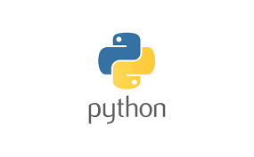
PYTHON PROGRAMMING
Python is an interpreted high level general-purpose programming language. Its design philosophy emphasizes code readability with its use of significant indentation.
Its language constructs as well as its object-oriented approach aim to help programmers write clear, logical code for small and large scale projects.

Slide 5
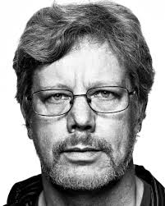
Python is a general purpose interpreted, interactive object-oriented and high-level programming language.
Python was created by Guido van Rossum is the 80’s and early 90’s. Like Perl, python source code is now available under the general public licences Perl, python source code is now available under the general public licences .

Slide 6
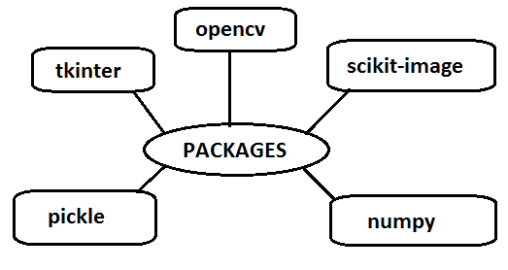
PACKAGES

Slide 7
PYTHON TKINTER
Tkinter is the standard GUI library for Python. Python when combined with Tkinter provides a fast and easy way to create GUI applications.
Tkinter provides a powerful object-oriented interface to the Tk GUI toolkit. Creating a GUI application using Tkinter is an easy task. All you need to do is perform the following steps −
Import the Tkinter module .
Create the GUI application main window.
Add one or more of the above-mentioned widgets to the GUI application .Enter the main event loop to take action against each event triggered by the user.

Slide 8
NUMPY
NumPy is the fundamental package for scientific computing in Python. It is a Python library that provides a multidimensional array object, various derived objects (such as masked arrays and matrices), and an assortment of routines for fast operations on arrays, including mathematical, logical, shape manipulation, sorting, selecting, I/O, discrete Fourier transforms, basic linear algebra, basic statistical operations, random simulation and much more.

Slide 9
OPENCV
OpenCV is a huge open-source library for computer vision, machine learning, and image processing. OpenCV supports a wide variety of programming languages like Python, C++, Java, etc.
It can process images and videos to identify objects, faces, or even the handwriting of a human.
When it is integrated with various libraries, such as Numpy which is a highly optimized library for numerical operations, then the number of weapons increases in your Arsenal i.e whatever operations one can do in Numpy can be combined with OpenCV.

Slide 10
SCIKIT-IMAGE
Scikit-image (formerly scikits.image) is an open-source image processing library for the Python programming language.
It includes algorithms for segmentation, geometric transformations, color space manipulation, analysis, filtering, morphology, feature detection, and more. It is designed to interoperate with the Python numerical and scientific libraries NumPy and SciPy.

Slide 11
PYTHON PICKLE
Python pickle module is used for serializing and de-serializing a Python object structure. Any object in Python can be pickled so that it can be saved on disk.
What pickle does is that it “serializes” the object first before writing it to file. Pickling is a way to convert a python object (list, dictionary, etc.) into a character stream.
The idea is that this character stream contains all the information necessary to reconstruct the object in another python script.

Slide 12
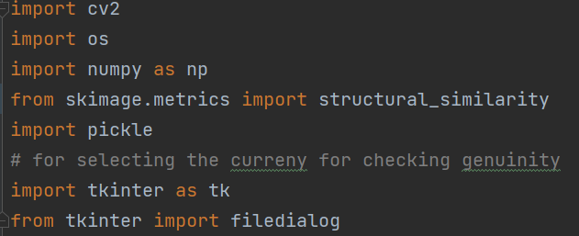
Fake currency detection
Here we are using packages like tkinter, opencv-python, numpy, scikit-image , pickle.

Slide 13
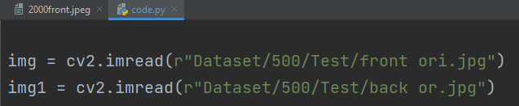
Now we will be setting a standard currency which will be used for comparing the results in code.py

Slide 14
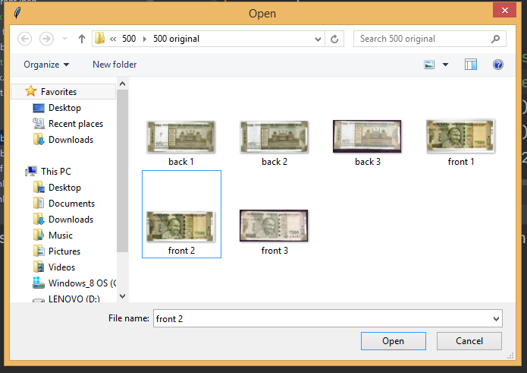
We are going to select the image which we need to
check whether it is fake or original.

Slide 15
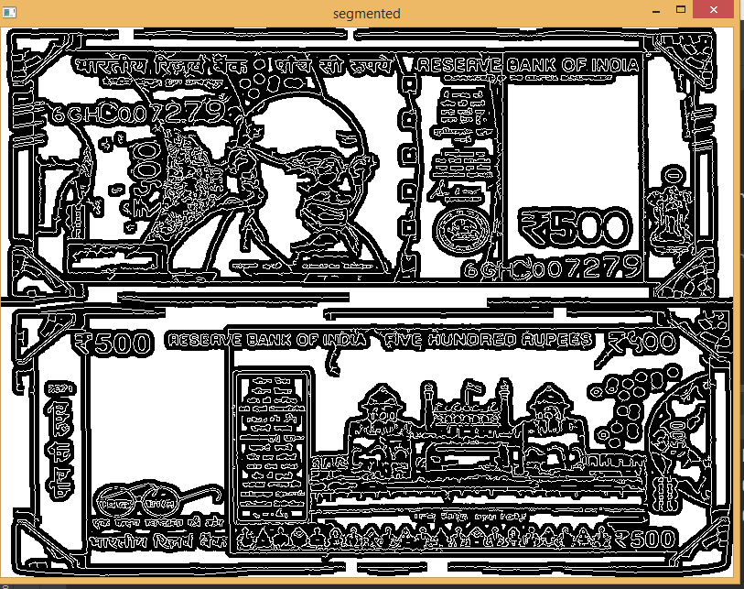
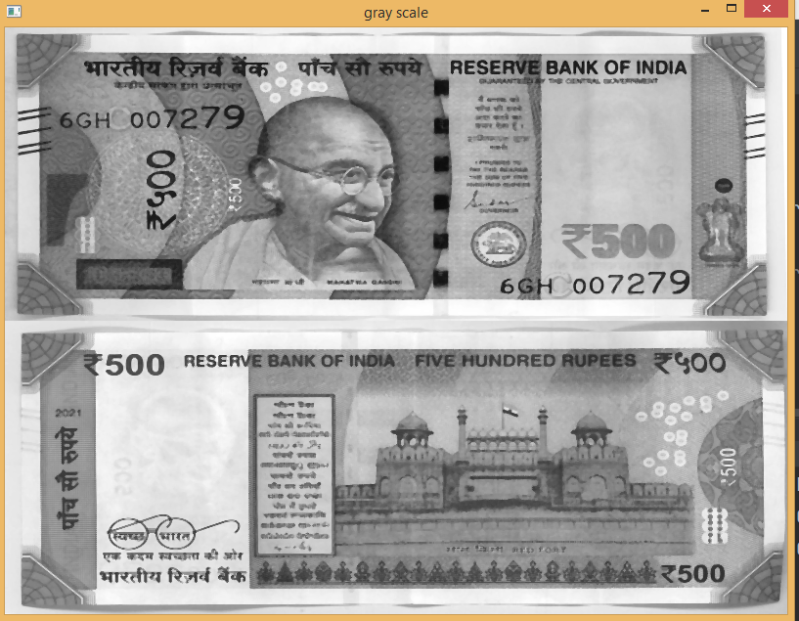
SEGMENTATION AND SCALING

Slide 16
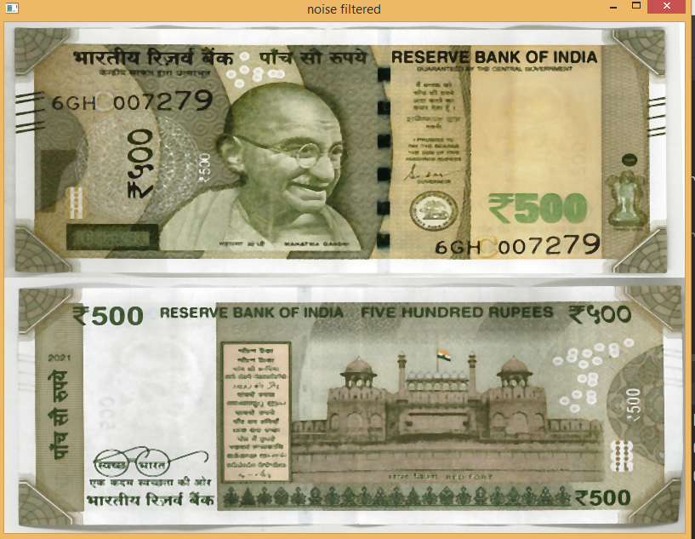
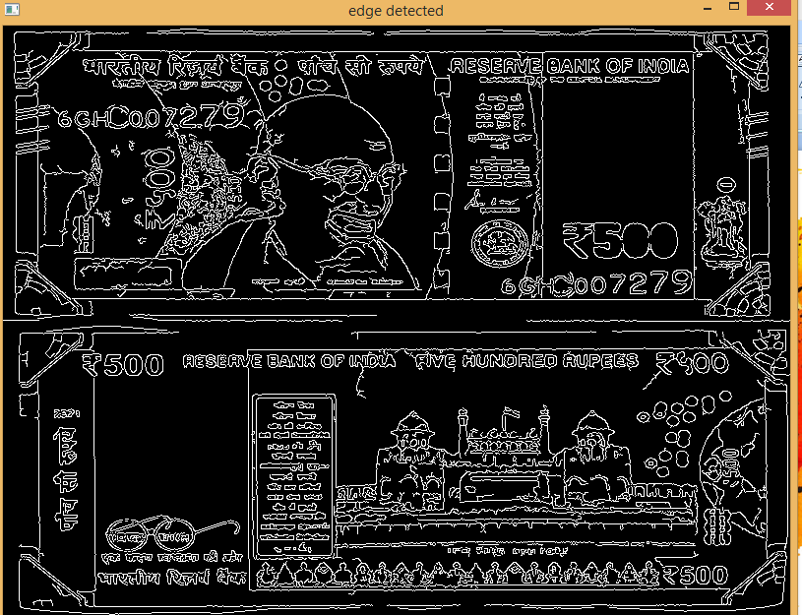

Slide 17
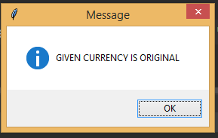
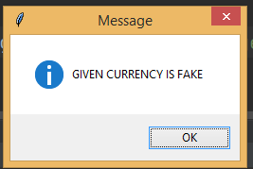
OUTPUT SCREENS

Slide 18
CONCLUSION AND FUTURE SCOPE
Our project will be helpful for the common people who are technically not involved in daily life. This will help to aware people to identify the fake currency.
Our proposed system could replace the hardware system in some initial stages of currency verification process.

Slide 19
SUMMARY
Fake currency detection is a serious issue worldwide, affecting the economy of almost every country including India. Currency duplication also known as counterfeit currency is a vulnerable threat on economy. It is now a common phenomenon due to advanced printing and scanning technology . By this type of projects we can reduce these scams in day to day life.
We have learnt the different types of modules like TKINTER , NUMPY, SCIKIT-IMAGE , PICKLE , OPENCV-PYTHON. We have developed an image processing algorithm which can detect the notes either fake or original.

Slide 20
THANK YOU

